Slide 1
Data Tribe: Disease Identification
Team 225
Artificial intelligence (AI) is predicted to have profound effects on the future of video capsule endoscopy (VCE) technology. So, our job is to build a machine learning/deep learning model to recognize the disease label of the respective images.
The goal is to build a deep learning model to classify images based on disease labels. The algorithms we are planning to use are deep neural networks, pretrained models to get better accuracy.
The project is useful in health care field particularly to identify chronic and malignant diseases in children and adults.
The hackathon them it is connected to Artificial intelligence/ Machine learning. We leverage AI/ML algorithms to help support diagnostics.
The data we are planning to use is Kvasir-capsule image data. It has nearly 70k images and their respective disease labels.

Slide 2
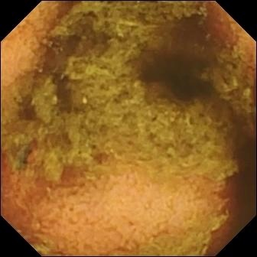
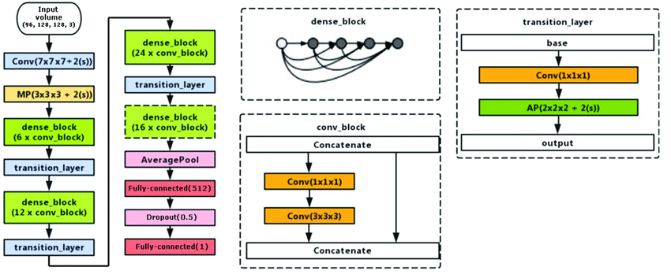
Team 225
We as a team collaborate on this idea by hosting weakly team meetings, creating a supportive environment, identifying each person's strengths, communicating expectations clearly, and mainly brainstorming the ideas related to health care field which will be helpful to the doctors or patients. We plan to collaborate same as before and we would treat mistakes as an opportunity to learn.
This project has potential to go into the market once it’s succeeded and gives best accuracy. We will build a mobile application/website which takes input image and gives output results. Currently, we are doing this for one disease but in future we can extend it to many diseases so it will be easy for doctors as well as to patients/people who doesn’t have any medical knowledge to identify diseases just using our website/application from images

